Slide 1
Kentucky Leadership Academy
Leadership Networks
January 13, 2011
Notes:
Hello again and thanks for having us back.
And thank you for braving the weather. I love the snow and so enjoyed building snowmen growing up and still do, but don’t have time these days. & I Don’t respond to the cold as well as used to. So building this snowman is as close as it gets

Slide 2
Targets
I understand what is going on in our content leadership networks.
I can use the networks’ resources to ensure quality deconstruction.
I understand the importance of text complexity & the value of math Q-taxons and how they can impact instruction.
I understand what Lexiles & Quantiles are and can use the information to plan.
Notes:
We have several targets for the segment. First we want to update you on what’s going on in the leadership networks
We then want to share some deconstruction resources that we’ve recently developed.
In addition, I will discuss the importance of text complexity /lexiles in our work with student achievement & the new standards

Slide 3
What’s Happening?
January-
CASL- Developing Student Friendly Targets; Target /Method Match Activity;
Standards-Review deconstruction process: “Rules of Thumb” ; Feedback Form
CHETL: Article: Ideal learning Culture ; Mind Sets
Leadership- Mini Facilitator Sessions based on participant needs
February-
CASL-Chapter 7 Performance Assessment (tasks & rubrics)
Standards: Process to Identify gaps & Begin mapping the year
CHETL- Assessment Literacy
Leadership- Participant sessions
Notes:
CASL-Spent several months deconstructing & now what to share the process of creating SF ones & then how to match those targets to the most effective assessment method (chap 4)
STDS- we’ve created several resources to assist with process and will look at those in a few minutes
CHETL-read
Leadership-new …feedback..addressed needs
Feb-participants will co or facilitate more content session based on needs of group
Remain busy and fighting the weather

Slide 4
Mini – Sessions at CKEC
ELA | MATH
Effective Meetings: How to plan, hold, & lead your peers | Strategies to Close the GAP
Text Complexity / Lexiles: What they mean & how to use them | Quantiles – a resource for intervention & differentiation
The Standards: Navigating & Understanding | Literacy Strategies to Help Kids Better Learn Math
Formative Assessment: The What & How | How to Differentiate with Formative Assessment
CHETL: What it means & connection to PLC’s | Menu of Options: What can should this look like?

Slide 5
Deconstruction Resources
Snowy Reminder ~ Days Like These?
Flowchart
CASL Point #3
Quality Control Rubric
“Rules of Thumb”
Feedback Form
Notes:
So let’s review deconstruction:
Process/directions, CASL Common point # 2 targets , Decon Template,
Saw great growth in the understanding & value of the process, but also saw some areas where we could provide more explantion and clarify some points
Handout packet

Slide 6
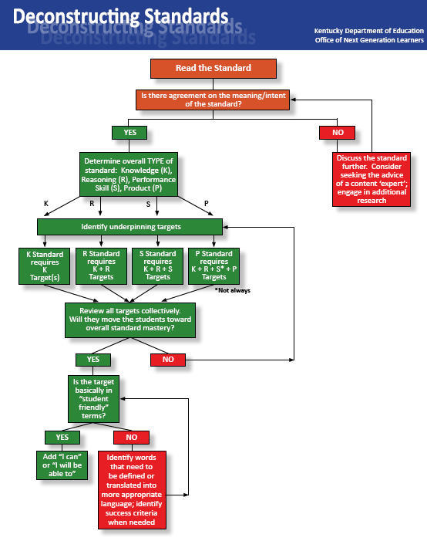

Slide 7
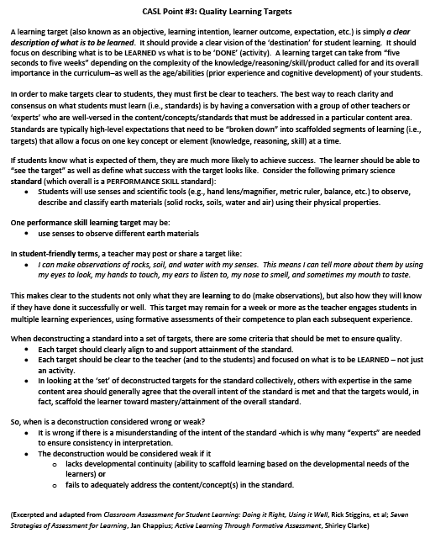

Slide 8
Sample Rubric for Quality Control Questions to Guide our Thinking
-Did deconstruction capture the intended learning?
-Has the target been classified correctly?
Criteria | Weak | Strong
Language is intended for the teacher audience. | Language is unclear and it doesn’t match the intended learning. | Language is written to make sure the intended learning is clear. Targets can easily be converted to student and parent friendly language if necessary.
Learning targets are focused directly on the standard at hand | Learning targets include all knowledge/skills needed – even ones that fit previous grades or other standards. | Learning targets stay within the scope of the standard (not previous skills needed).
Targets focus on what should be learned versus what is to be done. | Targets include activities that will help students reach the learning target. | Targets focus on what should be learned versus what is to be done.
Vision of each learning target is clear. | Exact goal of targets is unclear. | Learning target goals are clearly stated so that the learning is defined.
Notes:
Denise: Rubric from last month/ handout to them
Other Facilitators: Pass out standards from last meeting to create SF targets from

Slide 9
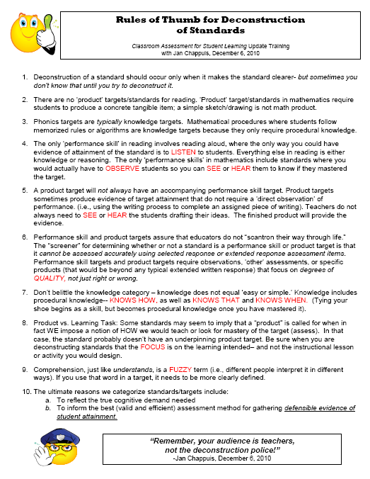

Slide 10
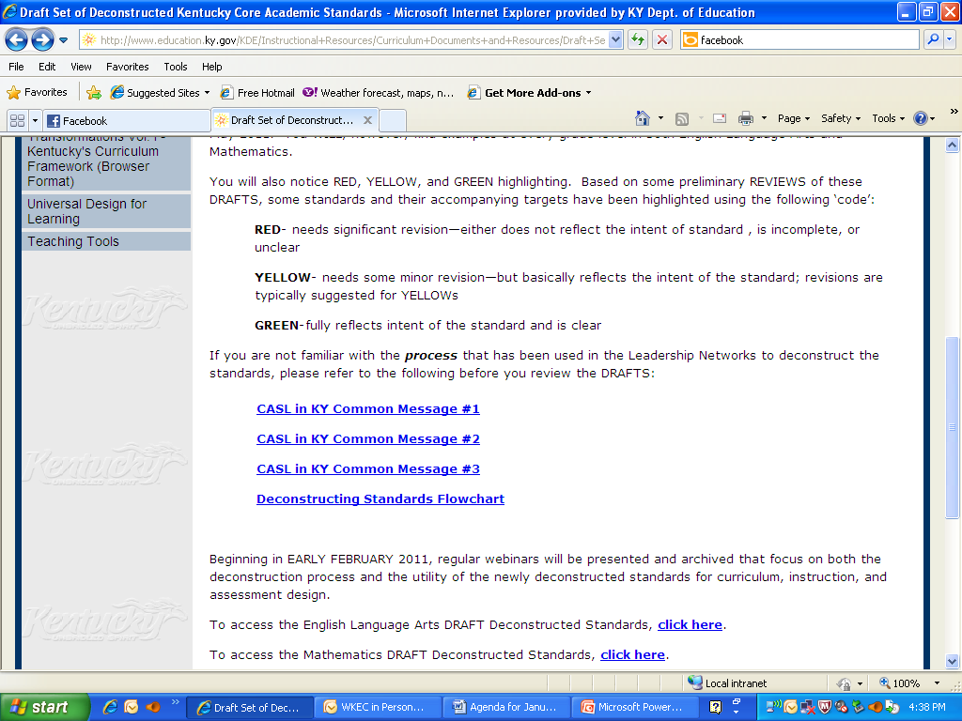
Notes:
RED- needs significant revision—either does not reflect the intent of standard , is incomplete, or unclear
YELLOW- needs some minor revision—but basically reflects the intent of the standard; revisions are typically suggested for YELLOWs
GREEN-fully reflects intent of the standard and is clear

Slide 11
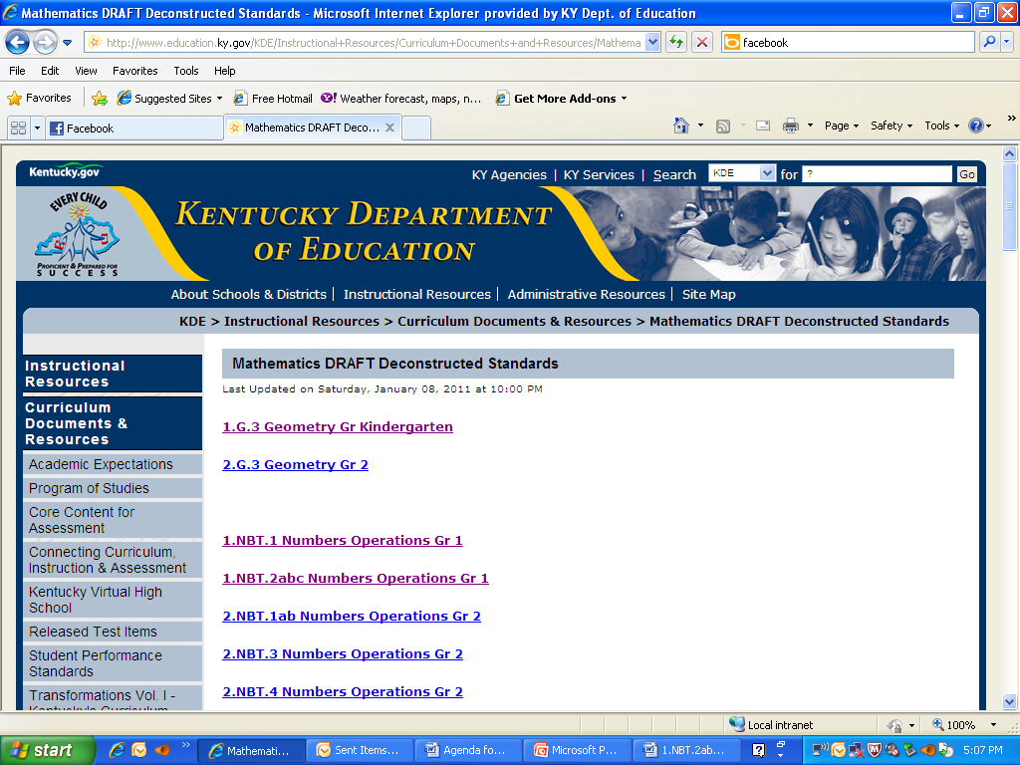

Slide 12
Why is this especially difficult in Math?
Geometry- Graph points on the coordinate plane to solve real-world and mathematical problems.
5.G .1 Use a pair of perpendicular number lines, called axes, to define a coordinate system, with the intersection of the lines (the origin) arranged to coincide with the 0 on each line and a given point in the plane located by using an ordered pair of numbers, called its coordinates. Understand that the first number indicates how far to travel from the origin in the direction of one axis, and the second number indicates how far to travel in the direction of the second axis, with the convention that the names of the two axes and the coordinates correspond (e.g., x-axis and x-coordinate, y-axis and y-coordinate).
Number and Operations Fractions-Develop understanding of fractions as numbers.
3.NF.1 Understand a fraction 1/b as the quantity formed by 1 part when a whole is partitioned into b equal parts; understand a fraction a/b as the quantity formed by a parts of size 1/b.

Slide 13
What is a student friendly learning target?
Subject
Topic
MATH
Decimals
Page 152 in the book
Going on a decimal hunt
Read decimals and put them in order
I can read decimals and put them in order. This means I can use the correct place value names and show the order of decimals based on their value.
Assignment
Activity
Learning Target
Learning Target
Learning Target
With success criteria

Slide 14


Burning Questions
What are your teacher leaders being asked to think about?
Notes:
Allow 3min for 2nd group discussion
Link prezi – as each question appears have reporter read the group sentence.
Finish by 9:15
http://prezi.com/ak574fxxoobm/copy-of-burning-questions/

Slide 15
Criteria for reviewing deconstructed standards
  Are the targets clear as written?
  Do the targets collectively reach the intent of the standard?
  Are the targets categorized correctly? (Knowledge, Reasoning, Performance, Product)
  Feedback is open to participants, selected groups, and Kentucky educators.
Timeline ~ updates weekly
Link:http://www.education.ky.gov/KDE/Instructional+Resources/Curriculum+Documents+and+Resources/Draft+Set++of+Deconstructed+Kentucky+Core+Academic+Standards.htm

Slide 16
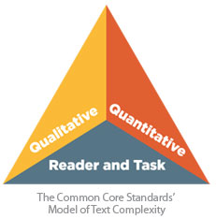
Text Complexity
Qualitative : Levels of meaning, structure, language conventionality and clarity, and knowledge demands
Quantitative: Readability measures and other scores of text complexity
Matching reader to text and task: Reader variables (such as motivation, knowledge, and experiences) and task variables (such as purpose and the complexity generated by the task assigned and the questions posed)
Appendix A
Notes:
Complexity of what students read ; how easy/difficult a text is to read

Slide 17
Why Does It Matter?
One of the key requirements of the Common Core State Standards for Reading is that all students must be able to comprehend texts of steadily increasing complexity as they progress through school. By the time they complete the core, students must be able to read and comprehend independently and proficiently the kinds of complex texts commonly found in college and careers.

Slide 18
Research
Key points which fueled the need for common standards across the states.
-The text complexity of K-12 textbooks has become "easier“ in last 50 yrs.
-The text demands of college and careers have remained consistent or increased over the same time period.
- Current standards, curriculum, and instructional practice have not done enough to foster independent reading of complex texts particularly in the case of informational texts.
As a result, there is a significant gap between students' reading abilities and the text demands of their postsecondary pursuits.

Slide 19
Findings
ACT, Inc., 2006 released a report called Reading Between the Lines
Clearest differentiator was students’ ability to answer questions associated with complex texts.
Findings held for male and female, all racial/ethnic groups, and from families with varying incomes
2008–2009 only 53 percent of students achieved reading benchmark score ; increase from 04–05 was not statistically significant. (ACT2009).
Notes:
With the knowledge of all the research and the fact that kids need to be more proficient with complex texts,
That’s where lexiles come into play

Slide 20

Lexiles: What, Why, How
The Lexile Framework® for Reading is a scientific approach to measuring text difficulty and reading ability.
A student gets his or her Lexile reader measure from a reading test or program.
The idea behind The Lexile Framework : if we know how well a student can read and how hard a specific book is to comprehend, we can predict how well that student will likely understand the book.
100,000 Books
80 million articles
60, 000 websites
www.lexile.com
Notes:
putting both texts and readers on the same scale to accurately match readers with reading materials.

Slide 21
Text Complexity / Lexiles
Additional research has shown that the texts required for many postsecondary pursuits fall within a Lexile range of 1200L to 1400L, while the text complexity of typical high school textbooks for grades 11 and 12 is about 1050L to 1165L. To put this gap in perspective, a 250L difference between reader ability and text complexity can cause a drop from 75-percent comprehension to 50-percent comprehension.

Slide 22


Grade Bands
Grade Band | Current Lexile Band | "Stretch" Lexile Band
K–1 | N/A | N/A
2–3 | 450L–725L | 450L–790L
4–5 | 645L–845L | 770L–980L
6–8 | 860L–1010L | 955L–1155L
9-10 | 960L–1115L | 1080L–1305L
11–CCR | 1070L–1220L | 1215L–1355L

Slide 23
Elementary School
Frog and Toad Are Friends 300L
Come A Tide 490L
Stone Fox 550L
Ramona Quimby, Age 8 860L
Current levels 2-5 450L-845L
New Levels 2–5 450L–980L

Slide 24
Middle School
The Diary of Anne Frank 1080L
Sing Down the Moon 820L
Narrative of the Life of Frederick Douglass, an American Slave. 1080L
        Current Level 6-8 860L-1010L
        New Level 6-8 955L-1155L

Slide 25
High School
Tale Of Two Cities 1130L
The House of the Seven Gables 1290L
Silas Marner 1330L
Current Level 9-12 960L-1220L
New Level 9-12 1080L-1355L
Notes:
Tale-Dickens
Marner-George Eliot
House - Hawthorne

Slide 26
Lexile Website
Let’s Take a Look
www.lexile.com

Slide 27
Did you know?
Over 50 percent of Kentucky college bound students must take a remedial math
class when entering college.
Over half of them fail at their first attempt.
How Can We Narrow the Achievement Gap in Math?

Slide 28

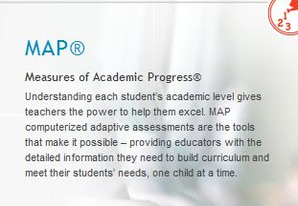

Math Readiness
Notes:
One type of measurement in which a number of schools and districts participate in MAP testing. It provides a computer based assessment measuring readiness. A teacher can use this score to better understand what there student knows and doesn’t know.
Math Computation | Math Facts
Computational skill is critical for mathematics success. According to the National Research Council (NRC, 2001), mathematics is comprised of 5 intertwined strands of proficiency, including procedural fluency, skill in carrying out procedures flexibly, accurately, efficiently, and appropriately. According to the NRC, “students need to be efficient and accurate in performing basic computation with whole numbers”. Furthermore, students must learn to “use an algorithm for computation with multi-digit numbers as an important part of developing mathematical proficiency”

Slide 29

Correlates a students mathematical knowledge with the difficulty of math skills and topics at a specific grade.
Notes:
The quantile framework uses a developmental scale to measure student mathematics achievement, skill or concept difficulty and grade level. The taxonomy consists of mathematics skills that cover kindergarten through content typically taught in Geometry, Algebra II, Trigonometry and Pre-calculus. These mathematics skills are specific descriptions of expectations within the demands mathematics curriculums.

Slide 30
Sample Student Report
Student Name | School Year | District | School | Quantile Score
Mina Bowers | 2009-10 | ANY | ANY | 585
All students, grades 3-8 and 11, who participated in KY state testing will receive a quantile score.
Scores were released with individual student reports.
Notes:
This year Kentucky adopted the quantile framework and every student in grades 3-8 and 11th who participated in Ky state testing will receive a Q score. These scores were released with individual student reports. Here is an example of a report used by both Georgia and North Carolina. I would suspect KY’s will be similar. Notice the student received an actual score of 585 and also received a range highlighted in light blue.

Slide 31
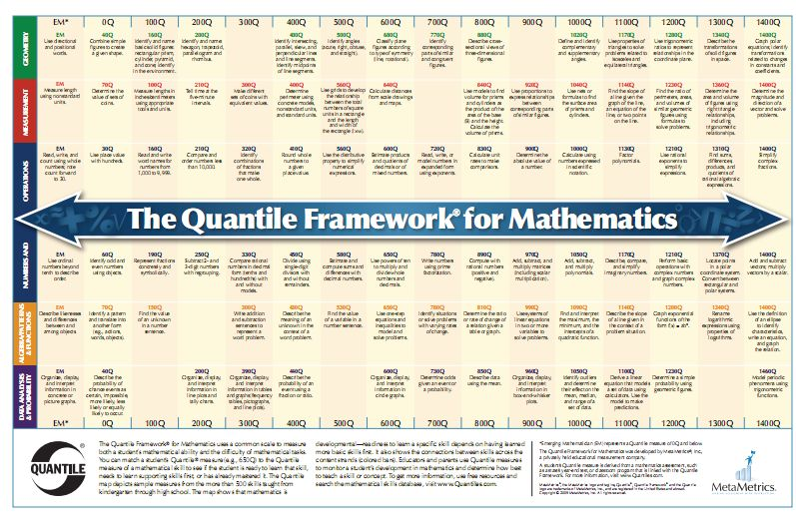
Notes:
So what does the number mean. The scale is developmental, therefore you will notice numbers along the bottom from EM (emergent) through 1400. This scale does not show all of the skills, rather it is designed to be the basic framework. You will notice numbers and operations are in the middle depicting their anchor to all mathematical concepts.

Slide 32
The Value of Q-Taxons
  Solve problems involving elapsed time.
  Use a coordinate grid to solve problems. Describe the path between given points on the plane.
  Divide using single-digit divisors, with and without remainders.
Which is most difficult?
In which grade is each introduced?
Which content strand does each come from?
Notes:
So which skill is the most difficult? Think about what each of these problems might look like.
CLICK
Question #2 –a) grade 4, b) grade 3, c) grade 5
CLICK
Question #3 – a)measurement, b) Probability & data analysis, c) numbers & operations
Why is skill difficulty a valuable piece of insight for teachers teaching mathematics?

Slide 33
The Value of Q-Taxons
  Solve problems involving elapsed time. 450Q
  Use a coordinate grid to solve problems. Describe the path between given points on the plane. 480Q
  Divide using single-digit divisors, with and without remainders. 450Q
Notes:
Essentially they are about the same difficulty level in Quantiles.
Skills at various grade levels might be the same measure. And you will see later that within a single grade level the Quantile measure might span a large range in terms of a Quantile measure.

Slide 34

What does a Quantile Measure mean?
Determines readiness
Provides pre-requisite skills
Monitors student math progress
Adapts instructional methods
Links big math ideas to core content
Forecasts student performance on the end of year tests
Notes:
Predicts readiness (successful performance of a skill/concept on the first night of homework after instruction takes place)
Describers pre-requisite skills needed to learn more advanced mathematical concepts
Monitors student math progress

Slide 35
The Quantile Framework is NOT:
An indicator of mastery or a test score
A list of mathematics skills
A curriculum for mathematics or a math program
Grade equivalent
A measure of a worksheet or test.
Notes:
Before we look at what the Quantile Framework is, let’s take a moment and discuss what it is NOT.

Slide 36
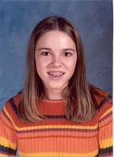
How can teachers use it in their classrooms?
Let’s Look At Ashleigh
7th Grade Student
Well behaved
Hard Worker
Teacher pleaser
Quantile: 675Q
Notes:
Let’s look at a specific student. Here is Ashleigh. She is a well behaved 7th grade student who is is a hard worker and a teacher pleaser. She is always prepared for class. Lately her math teacher has noticed Ashleigh having difficulty with integers.
CLICK
Her quantile score is 675

Slide 37
Model or compute with integers using multiplication or division. Q-810
810
800
750
700
Ashleigh
675
Notes:
Let’s look at the scale…it is a developmental scale, it gives an idea of the difficulty of the skill as you progress from kindergarten to pre-cal. In other words the complexity of the concepts increases as you move up. The lesson in which the teacher will be presenting in the classroom, read, is at the 810 Q level.
Click
Ashleigh's current level of understanding or readiness is 675, plus or minus 50. She will have difficulty being successful if her So what can a teacher do?
CLICK
Ashleigh, given her current readiness, will have difficulty being successful if her teacher does not do something to help provide necessary pre-requiste skills she will need to be successful.

Slide 38

Grade | Name | Quantile Measure
7 | Lee | 1035
7 | Henry | 980
7 | Kaleb | 940
7 | Destiny | 905
7 | Dustin | 850
7 | Crystal | 800
7 | Taquashia | 780
7 | Carlos | 755
7 | Ashleigh | 675
7 | Diana | 670
7 | Tony | 605
7 | Mina | 585
7 | Kyanna | 560
7 | Je Ree | 535
7 | Blake | 468
7 | Caroline | 460
A LOOK AT YOUR CLASSROOM
Notes:
There are many Ashleigh’s in every classroom. Here is an example of the readiness range of a typical 7th grade class. Quantiles measure students’ mathematics achievement, not their grade level. A class of 25 seventh graders will likely have students with a range of Quantile measures. Educators use those varied Quantile measures to target instruction and remediate as necessary, using tools and resources that match the students’ Quantile measures.
Some children will need more challenging mathematics while others will need scaffolding. Teachers will be able to use their students’ Quantile measures to forecast which students will have success with these skills and to identify those who may need to learn other skills or concepts before or during the lesson.

Slide 39
Differentiation?
How does the range of ability levels in the classroom match with the targeted skill (QTaxon) Quantile measure?
How will you help to prepare the students who are not ready for the topic?
Are there students who might need enrichment? How can their needs be addressed?

Slide 40
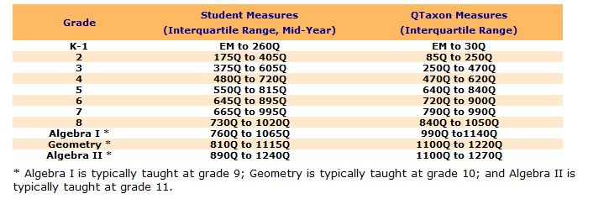
To interpret what a Quantile measure means for a specific student, two pieces of information are needed: (1) the Quantile score, and (2) the grade level during which the student received his or her Quantile score.
Notes:
Based on studies, metra metrics determined the following approximate Quantile ranges for each grade level. In understanding student measures, these represent about the middle 50% of the students.
To interpret what a Quantile measure means for a specific student, two pieces of information are needed: (1) the Quantile measure, and (2) the grade level during which the student received his or her Quantile measure.
For example, a higher Quantile measure within a specific grade range indicates that a student probably has very few problems with grade-level material (textbooks and assignments) in school. A lower Quantile measure indicates that a student most likely struggles to understand and be successful with grade-level material.

Slide 41
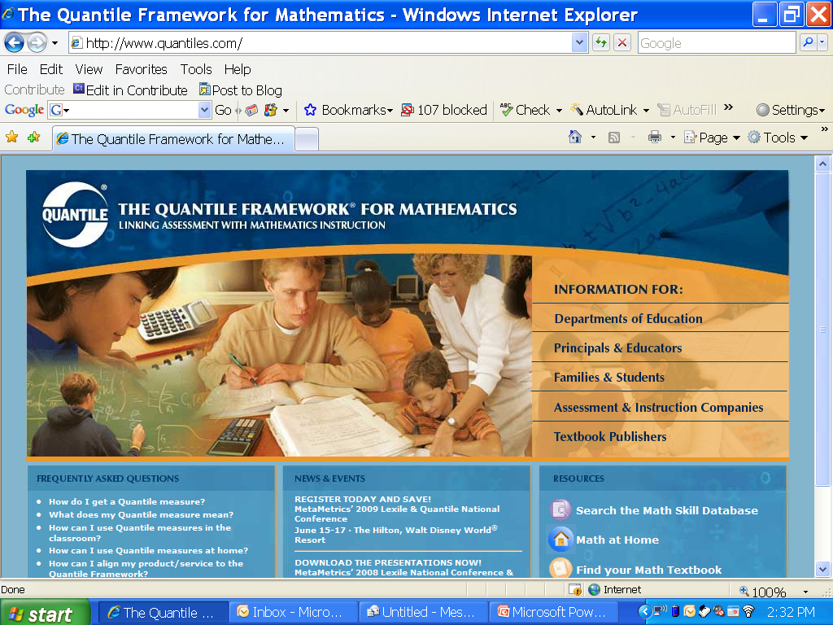
www.quantiles.com
Notes:
Let’s take a look around the website.
The first place to navigate would be the link for Principals and Educators

Slide 42
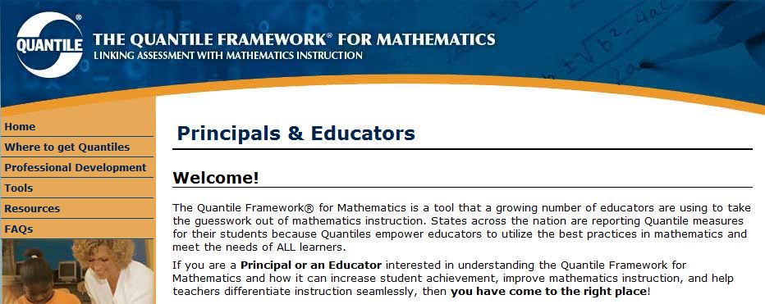
Tools

Slide 43
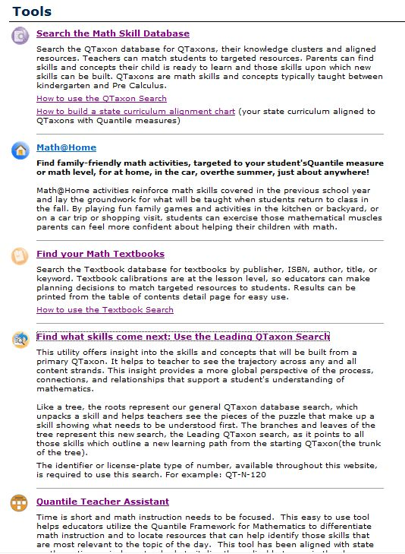
Start Here
Notes:
The tools site is the one you will probably use the most. I would like to go through some of these tools to show you how you can use them effectively in your classroom.

Slide 44
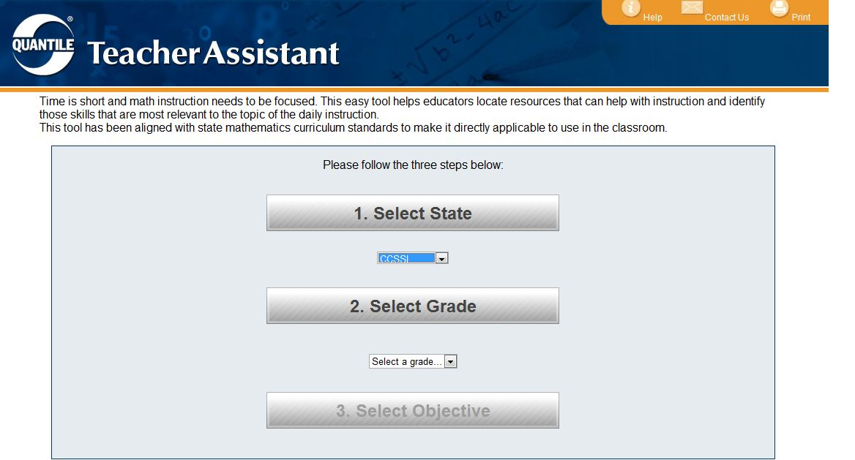
Contains new content standards
Notes:
We are going to choose grade 7 and objective on multiplying and dividing integers. Kentucky’s 4.1 standards are listed, however I am going to use the new core standards.

Slide 45
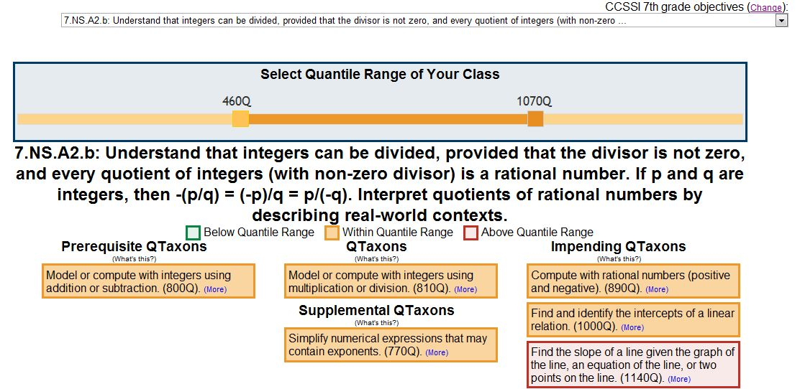
A closer look…
Describes a skill or concept that provides necessary foundation.
Will help to assist and enrich understanding
All students will need to be taught
Notes:
Click to show the various bullets.

Slide 46
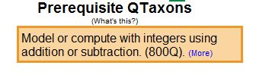
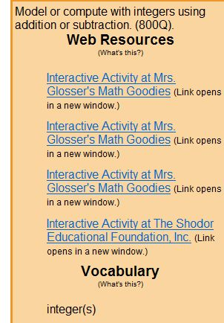
Contains essential vocabulary, web resources and instructional ideas
Notes:
When you click on more for this concept, here are the resources available.

Slide 47
Notes:
The tools site is the one you will probably use the most. If you have problems navigating the site, always got to the home site and click on tools.

Slide 48
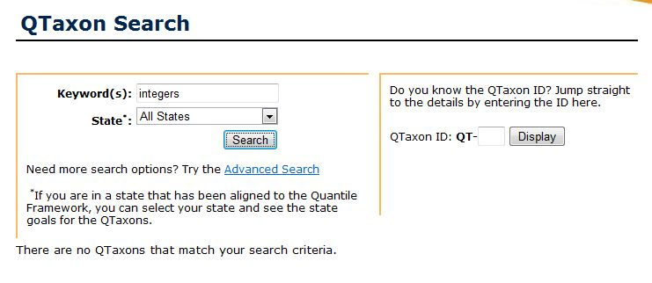
Keyword Search

Slide 49
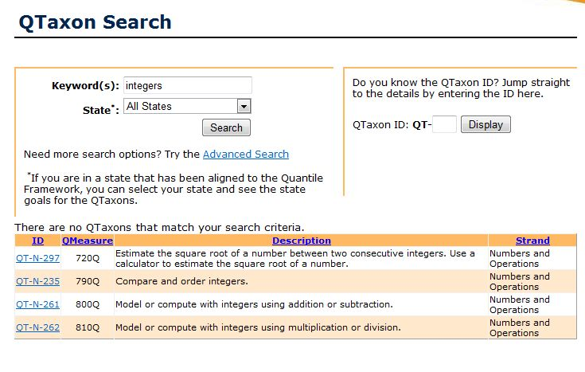
Notes:
If you know the content and want to know what skills may need to be taught prior to instruction or interested in the q rating, then you can do a search and find content.

Slide 50
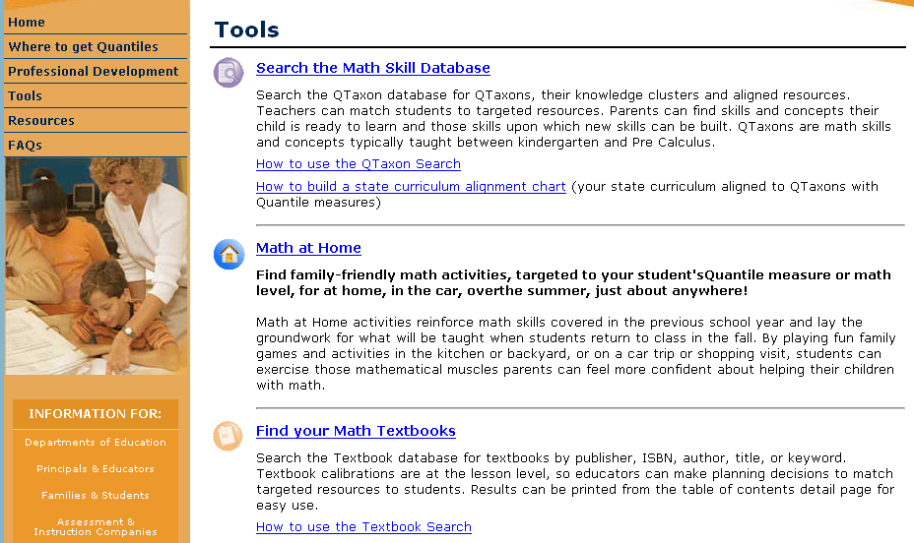

Slide 51
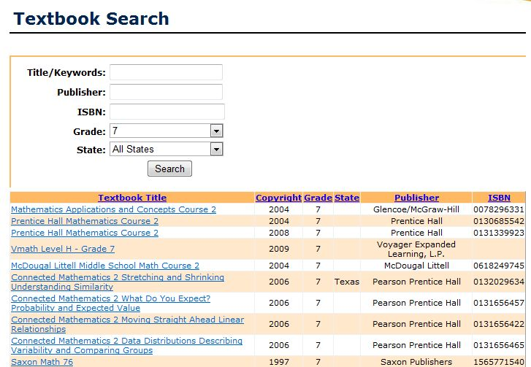
You can search your own textbook
Notes:
Not all textbooks are on the site. Only those which have granted permission to metrametrics are here.

Slide 52
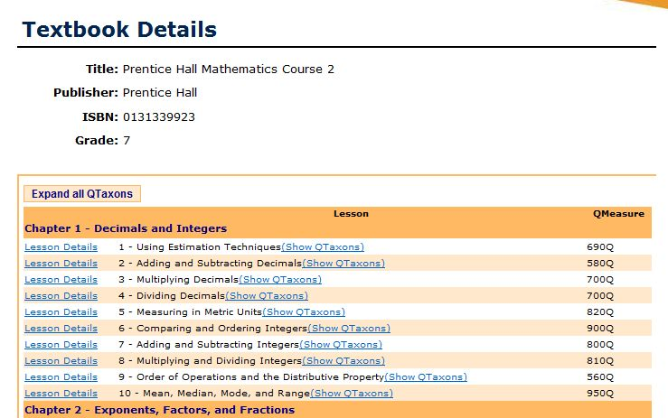
810Q

Slide 53
Advanced Search
Curriculum Alignment

Slide 54
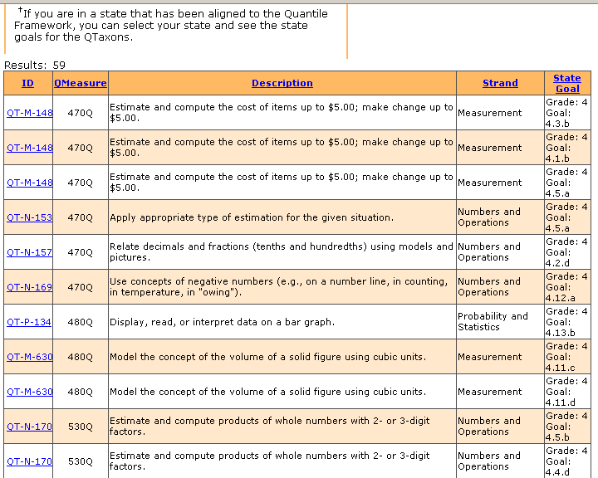
Ordered by Quantile Measure
Reorder the list by your state goals.
Notes:
Here is an example of the new core standards for grade 7.
The chart will show the QTaxons in order from the lowest Quantile measure to the highest. They can rearrange the alignment according to state goals by clicking on the heading of the last column. Or they can rearrange the state goals by content strands as defined by the Quantile Framework. There may be some discrepancies between state goal numeration and the content strand that the QF assigns to the QTaxons.

Slide 55
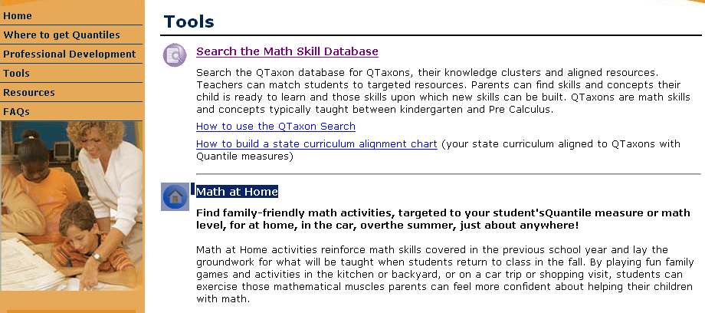
Math at Home

Slide 56
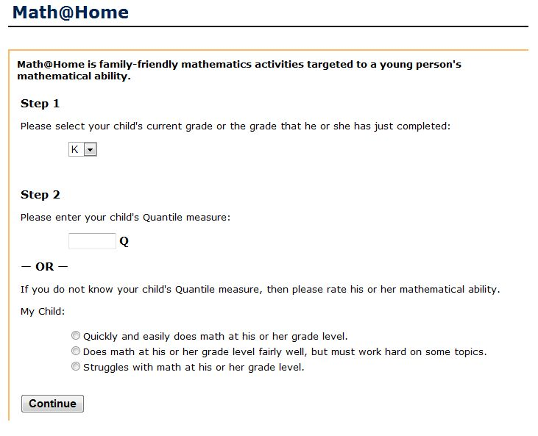
Even if you do not know your child’s Q score, you can use the site
Notes:
Even if you do not know the q score of a child, you can still use the quantile framework.

Slide 57
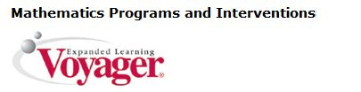



Where to get quantiles?
Notes:
Scholastic has purchased the rights to the quantile framework, therefore any of their programs now how both the lexile and quantile scores.

Slide 58
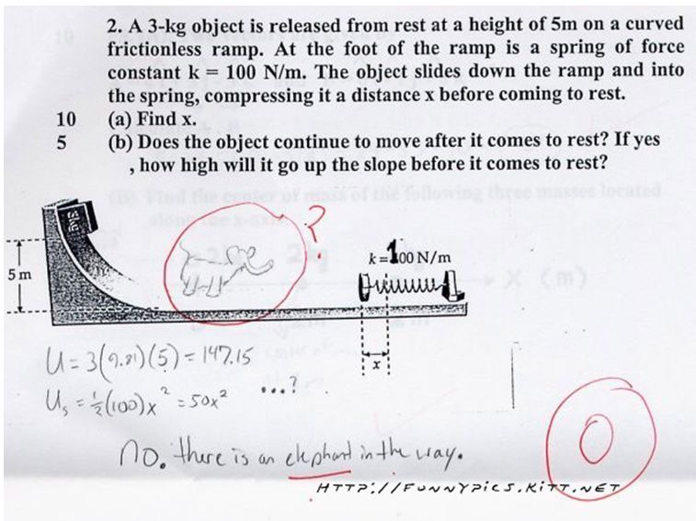
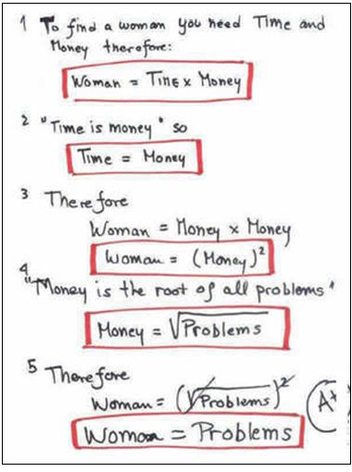
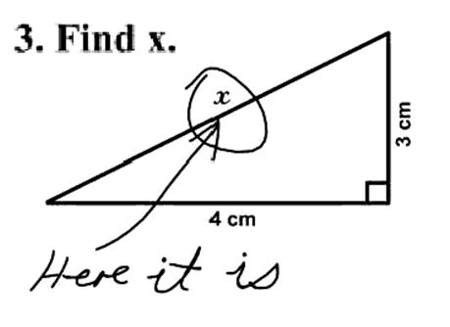
Math humor…
58
Notes:
Debbie
We want our kids to think & reason… not like this….

Slide 59

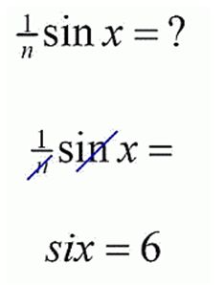
Understanding with Fidelity is Key to Success
“…a lack of understanding effectively prevents a student from engaging in the mathematical practices”
(CCSS, 2010, p. 8).
59
Notes:
Debbie
Priority: understanding of content

Slide 60
Targets
I understand what is going on in our content leadership networks.
I can use the networks’ resources to ensure quality deconstruction.
I understand the importance of text complexity & the value of math Q-taxons and how they can impact instruction.
I understand what Lexiles & Quantiles are and can use the information to plan.
Denise.rains@education.ky.gov
CKEC ELA Specialist
Debbie.waggoner@education.ky.gov
CKEC Math Specialist
Notes:
We have several targets for the segment. First we want to update you on what’s going on in the leadership networks
We then want to share some deconstruction resources that we’ve recently developed.
In addition, I will discuss the importance of text complexity /lexiles in our work with student achievement & the new standards

